Slide 1



Samsung Innovation Campus
AI Course

Slide 2

Credit Card Fraud Detection
Visionaries
AI Course

Slide 3


Credit Card Fraud Detection
UNIT 1. Introduction and Problem
1.1. Introduction
1.2. Problem Statement
UNIT 2. Solution Approch and Results
2.1. Solution Overview
2.2. Key Results
UNIT 3. Impact and Conclusion
3.1. Applications and Future Impact
3.2. Conclusion
Samsung Innovation Campus
VISIONARIES
‹3›
Notes:
Note:
3

Slide 4

Introduction
UNIT 1.1
Credit card fraud occurs with unauthorized transactions made
Stolen or fake card details often enable such fraudulent activities
These crimes result in financial losses and decreased customer trust
Our dataset contains thousands of real-world financial transactions
Features include time, amount, and anonymized variables V1–V28
Each transaction is clearly labeled normal or fraudulent case
This data supports building effective fraud detection machine models
Samsung Innovation Campus
VISIONARIES
‹4›

Slide 5
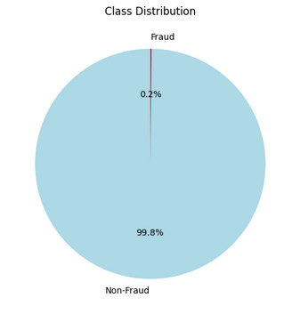
Problem Statement
1.2
Credit card fraud is a major problem
It causes significant losses for banks
Customers also experience stress and losses
Fraud cases are under 0.2 percent
This imbalance makes detection extremely challenging
Traditional models often miss fraud cases
They also create too many false alarms
Samsung Innovation Campus
VISIONARIES
‹5›

Slide 6
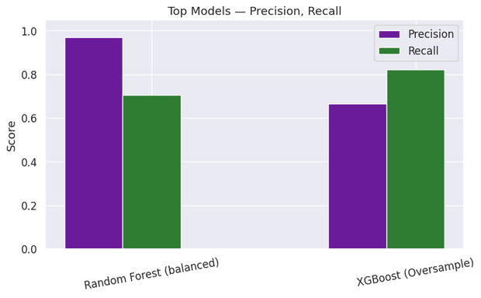
Solution Overview
2.1
We applied data balancing (SMOTE, oversampling) and tested multiple ML models. Random Forest (Balanced) achieved the highest precision, while XGBoost (Oversampling) achieved the highest recall, making them the most effective choices.
Samsung Innovation Campus
VISIONARIES
‹6›

Slide 7
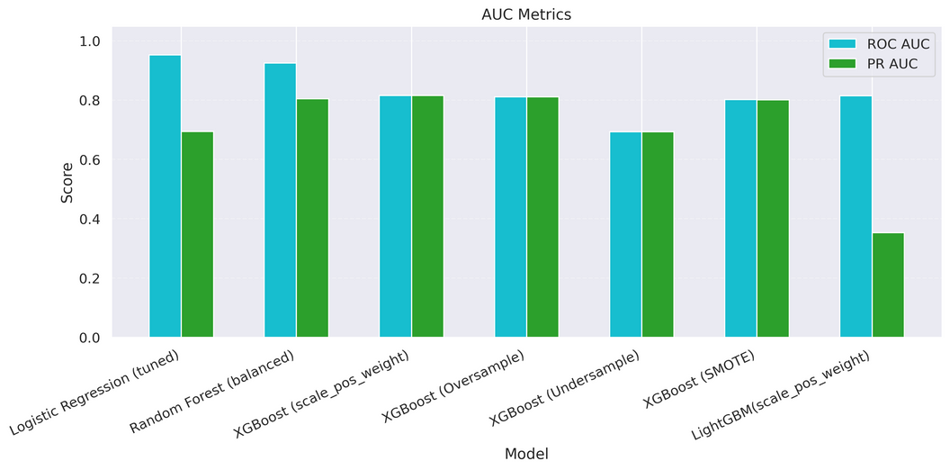
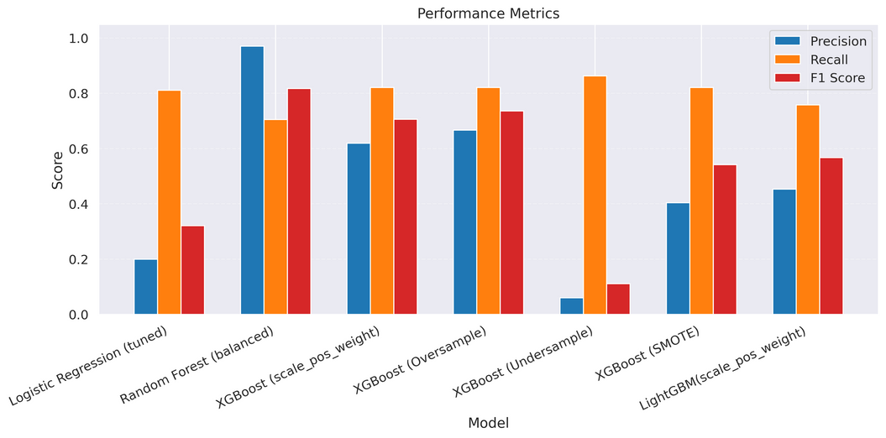
Key Results
2.2
Credit Card Fraud Detection Model Comparison
Samsung Innovation Campus
VISIONARIES
‹7›

Slide 8

Applications and Future Impact
3.1
Fraud detection plays a critical role in finance
It protects banks, customers, and digital payment platforms
Early detection reduces losses and strengthens financial security
The system prevents fraudulent activities before major damage
Future upgrades include real-time streaming transaction data
Diverse datasets improve adaptability to fraud variations
Deep learning models enhance accuracy and detection reliability
Overall, the solution ensures safer global financial operations
Samsung Innovation Campus
VISIONARIES
‹8›

Slide 9
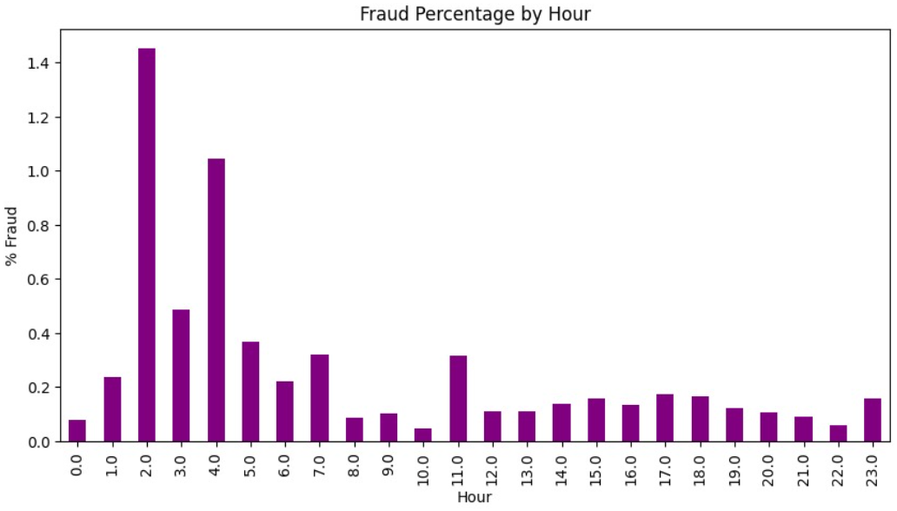
Conclusion
UNIT
3.2
While analyzing the data, we found fraud happens more in early morning hours.
This insight can later improve our fraud detection models.
Random Forest reduced false alarms, while XGBoost detected more fraud.
Samsung Innovation Campus
VISIONARIES
‹9›

Slide 10



ⓒ2021 SAMSUNG. All rights reserved.
Samsung Electronics Corporate Citizenship Office holds the copyright of book.
This book is a literary property protected by copyright law so reprint and reproduction without permission are prohibited.
To use this book other than the curriculum of Samsung innovation Campus or to use the entire or part of this book, you must receive written consent from copyright holder.

